Slide 1
Schematic Diagram
Submitted by:
Karamjot kaur
Student id- C0754576
Group 2

Slide 2

Introduction of project
IoT based visitor counter using BeagleBone Black is the finalized project for group 2.
This project is designed to count the visitors and to check the temperature at public places such as gyms, stores, shopping centers etc.
BeagleBone Black is the main MCU of this project.
The number of people present in store will be updated on the LCD in the store and on the webpage for remote use.

Slide 3
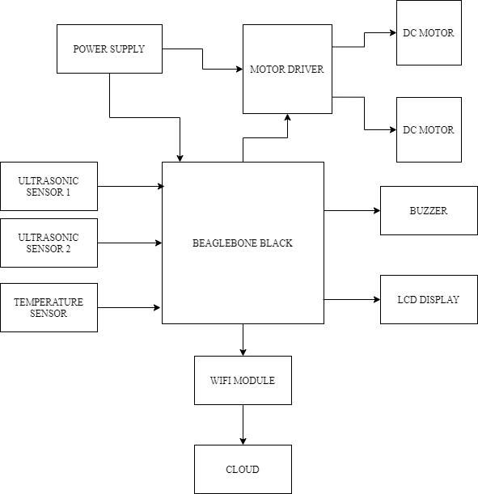
Block diagram of project
In this project ultrasonic sensors are used to check the presence of the customer and temperature sensor is used to check the temperature.
Motors are used to control the access at the entry and exit gate.
Wi-Fi module to used for cloud services.

Slide 4

Introduction of easyeda
EasyEDA is a simple EDA (Electronics Design Automation) and it allow students, engineers, makers etc. to design a schematic and PCBs.
It has more than 1 million free libraries and a user can create and import a new library.
It is integrated with LCSC components and user can refer to stock, check price and order component at any time during design process from China’s leading electronic distributer- LCSC.
Beside this, easyeda also provide services for PCB design with the help of JLCPCB to make the design to an industrial project.
It is free for now, but it is without easyeda support service.
The professional and enterprise versions are coming soon with support service, no advertisement and email support within 24 hours and the cost is $4.9/month and $9.9/month respectively.
It is compatible with Linux, Windows and Mac.

Slide 5
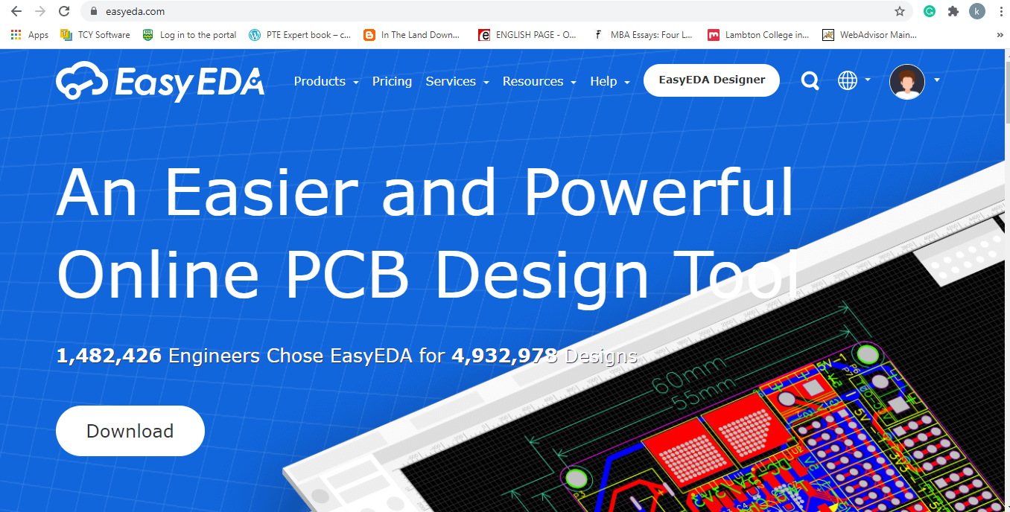

Slide 6

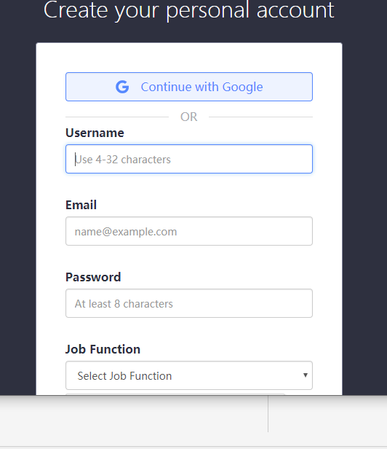
Getting started with easyeda
First step is to download the application(if the user wants) or a user can make schematic online and register.
Create your account by adding username, email ID and password.
Job function selected for this schematic is student.

Slide 7
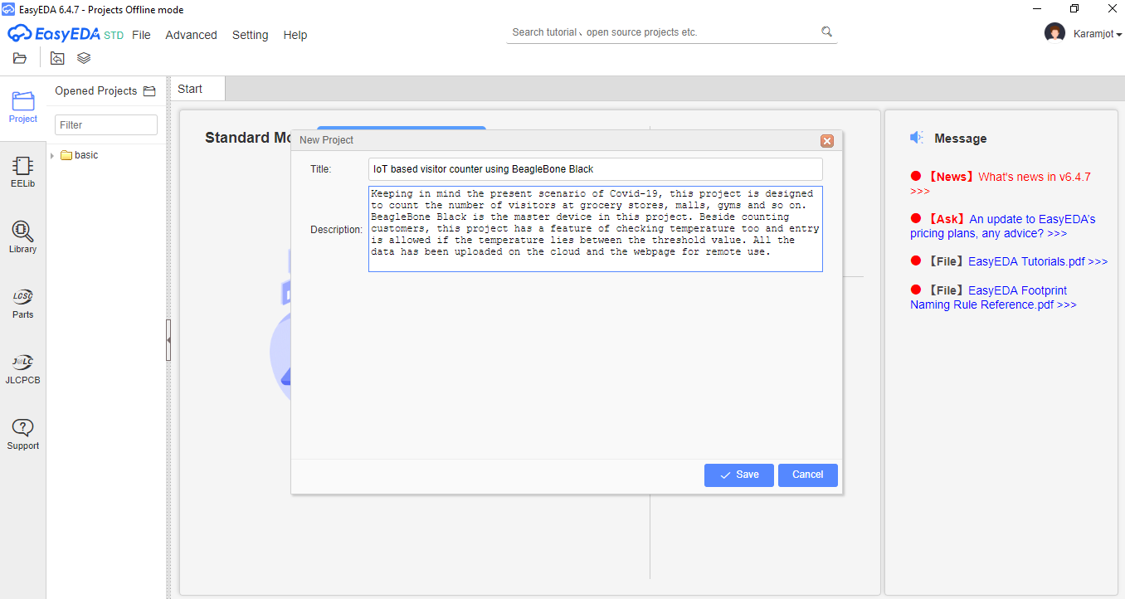
Creating new peoject
After logging in, next step is to create a new project.
Firstly, click on file and go to new, then new project and click on it.
A new window pops up and add title and description of project.
Lastly, click on save and a new project has been created.

Slide 8
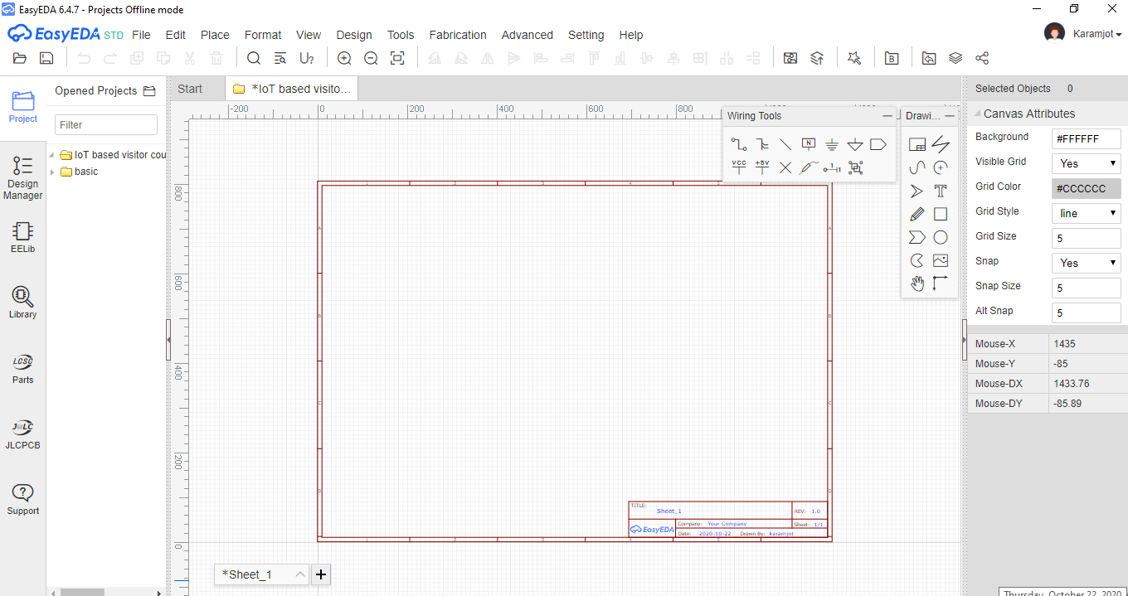
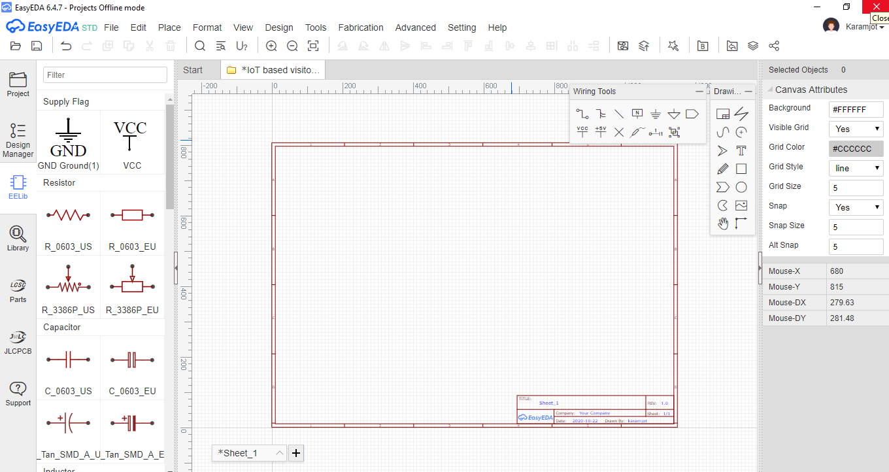
Workspace
This is the workspace layout of schematic design. Wiring and design tools are on the sheet.
On the left side, there are libraries such as design manager, EElib, library, LCSC and JLCPCB.

Slide 9
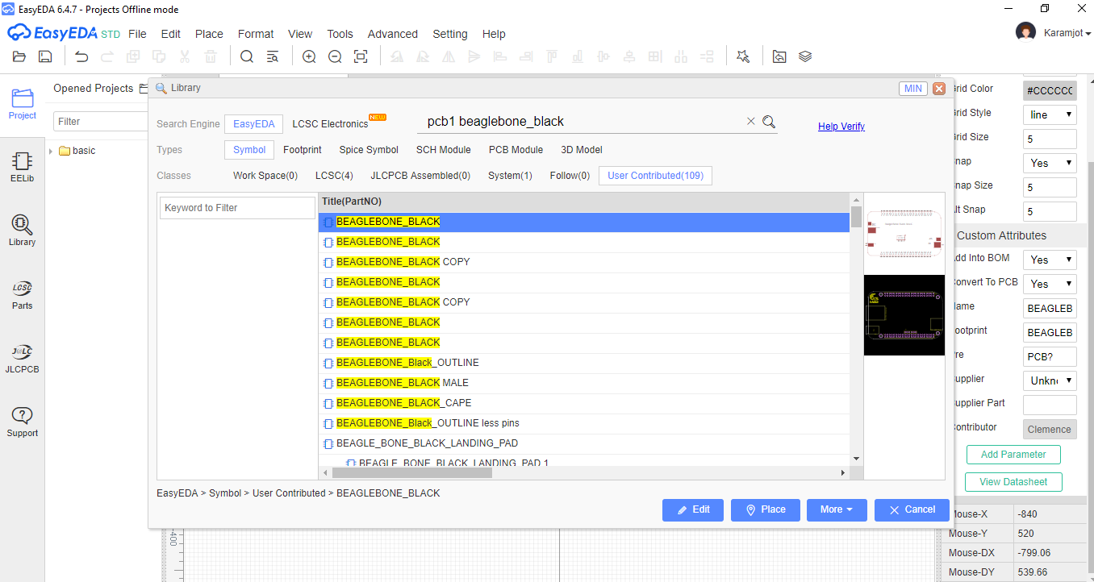
Searching components from library
To search a component, click on library and search a component. There are numerous options such as symbol, footprint, spice symbol etc.

Slide 10
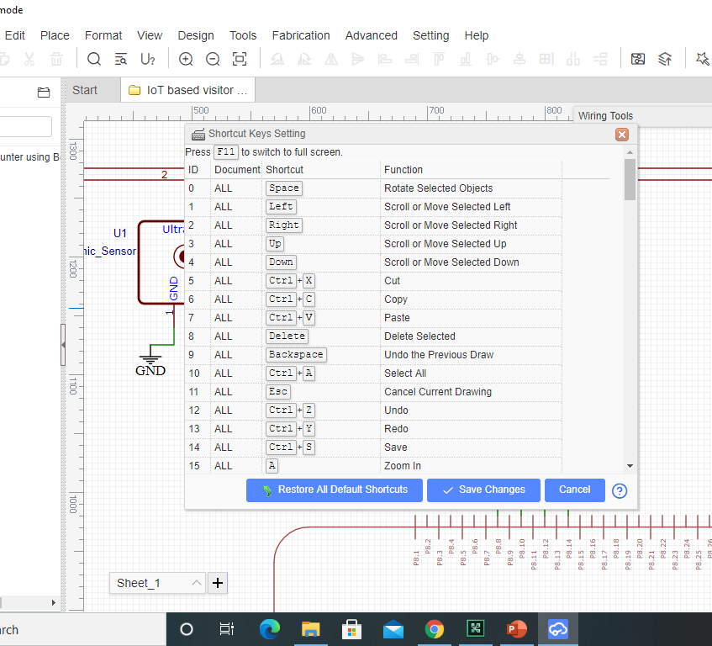
Shortcut keys
There are also short cut keys that can be used to edit the schematic design.
During this schematic design, following shortcuts are used:
Ctrl+X= cut
Ctrl+C= copy
Ctrl+V=paste
Delete= delete selected
Ctrl+A= select all
Esc= cancel current drawing
Ctrl +Z= undo
Ctrl+S=save
Up= scroll up
Down= scroll down

Slide 11
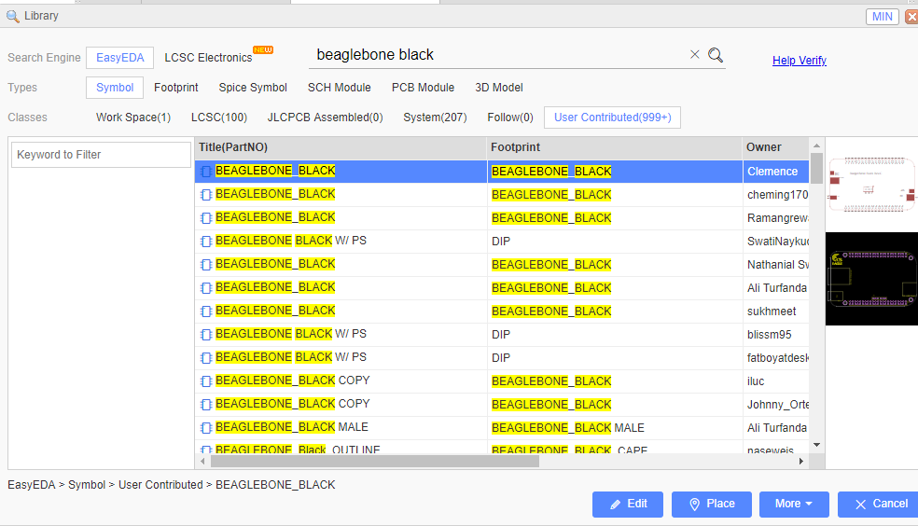
BeagleBone Black Rev. c
Beaglebone black is the master device of this project
It operates on 5v and an external 5V adaptor is used for the power supply of the beaglebone black.

Slide 12
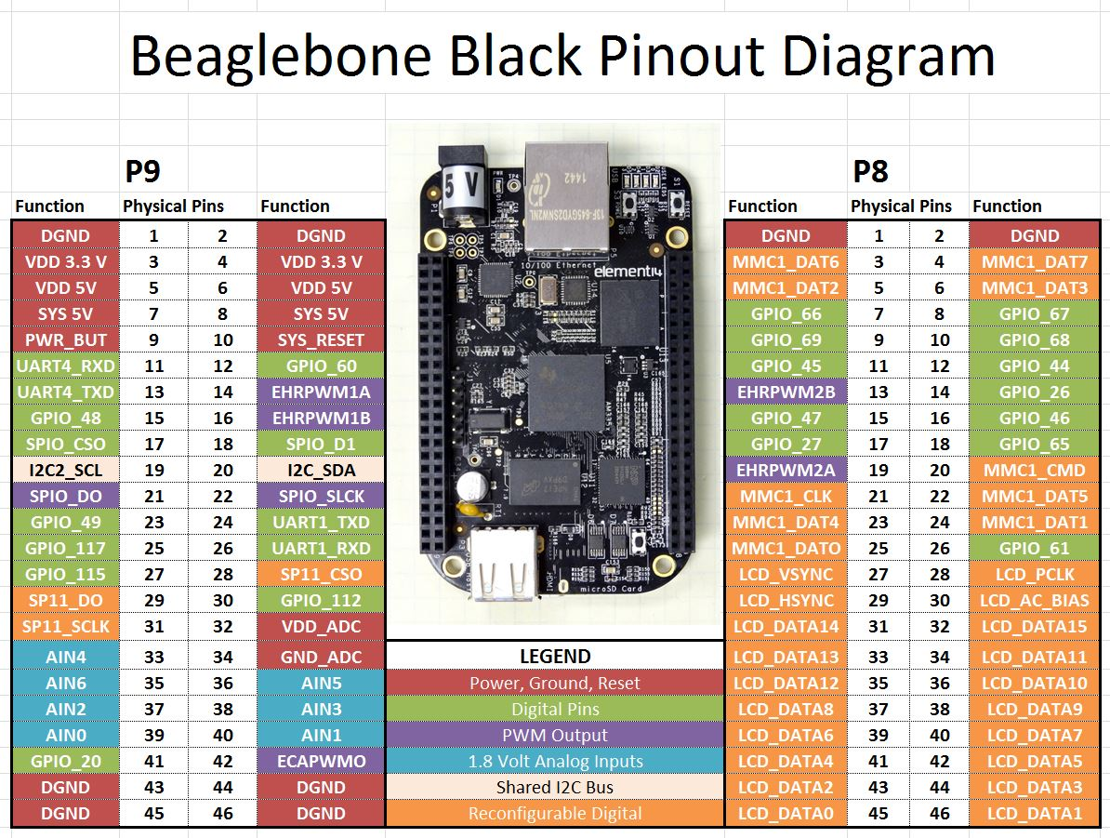
Pin description of Beaglebone black

Slide 13
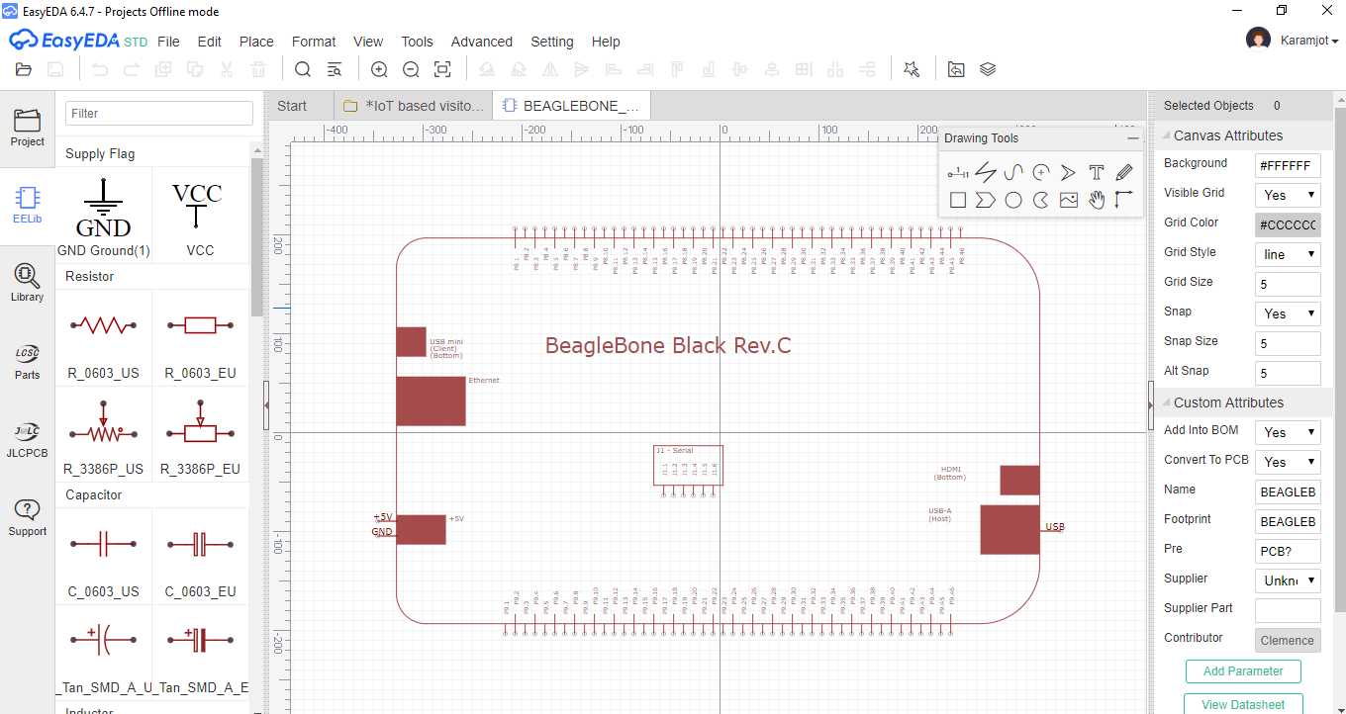
Beaglebone black in easyeda

Slide 14
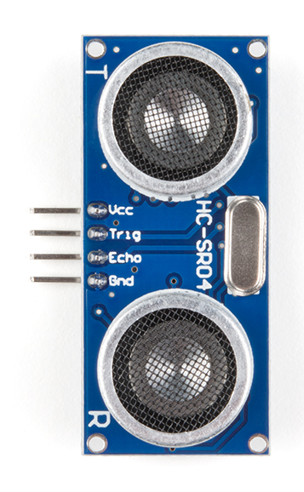
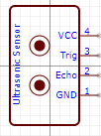
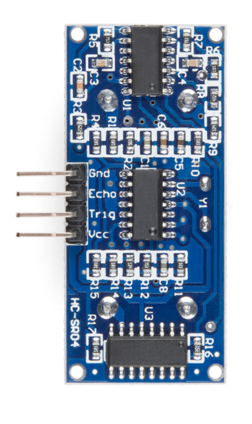
Ultrasonic Sensor
In this project, ultrasonic sensor is used to check the presence of customer
Working Voltage of sensor is 5 V .
Max Range is 4m
Min Range in 2cm

Slide 15
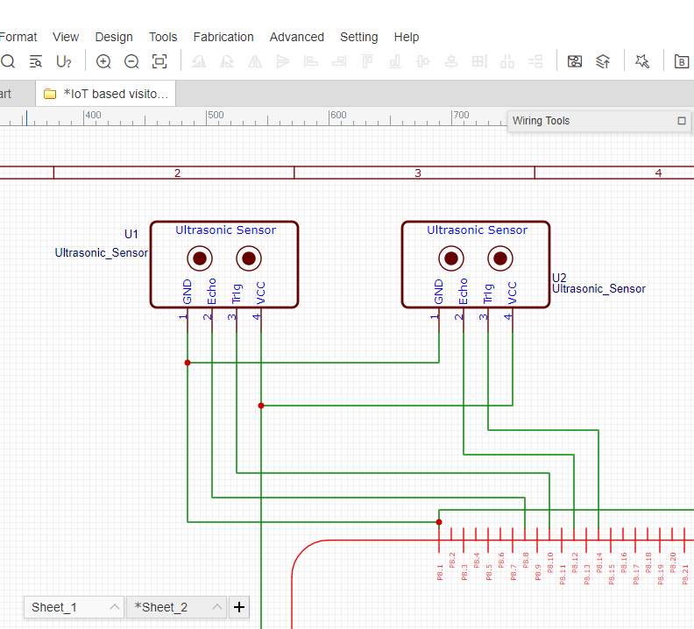
Connecting ultrasonic sensors to bbb
Ultra sonic sensors are connected using GPIO pins of BBB and the connections are as follow:
Echo pin of sensor 1 i.e. U1 is connected to pin 8 (port 8) of BBB
Trig pin of sensor 1 i.e. U1 is connected to pin 10 (port 8) of BBB
Echo pin of sensor 2 i.e. U2 is connected to pin 12 (port 8) of BBB
Trig pin of sensor 2 i.e. U2 is connected to pin 14 (port 8) of BBB
VCC of both sensors is connected to pin 5 of port 9
GND of both sensors is connected pin 1 of port 8

Slide 16
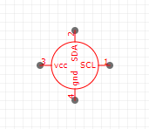
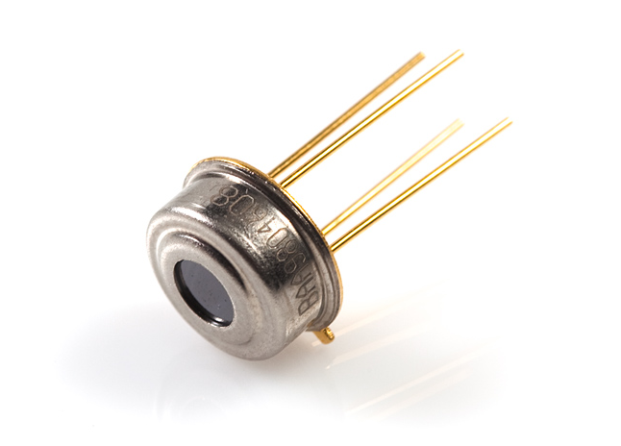
Temperature sensor
In this project, temperature sensor is used to check the temperature. A threshold value will be mentioned and customers having temperature under the threshold value will be allowed to enter.
Its working voltage is 5V.

Slide 17
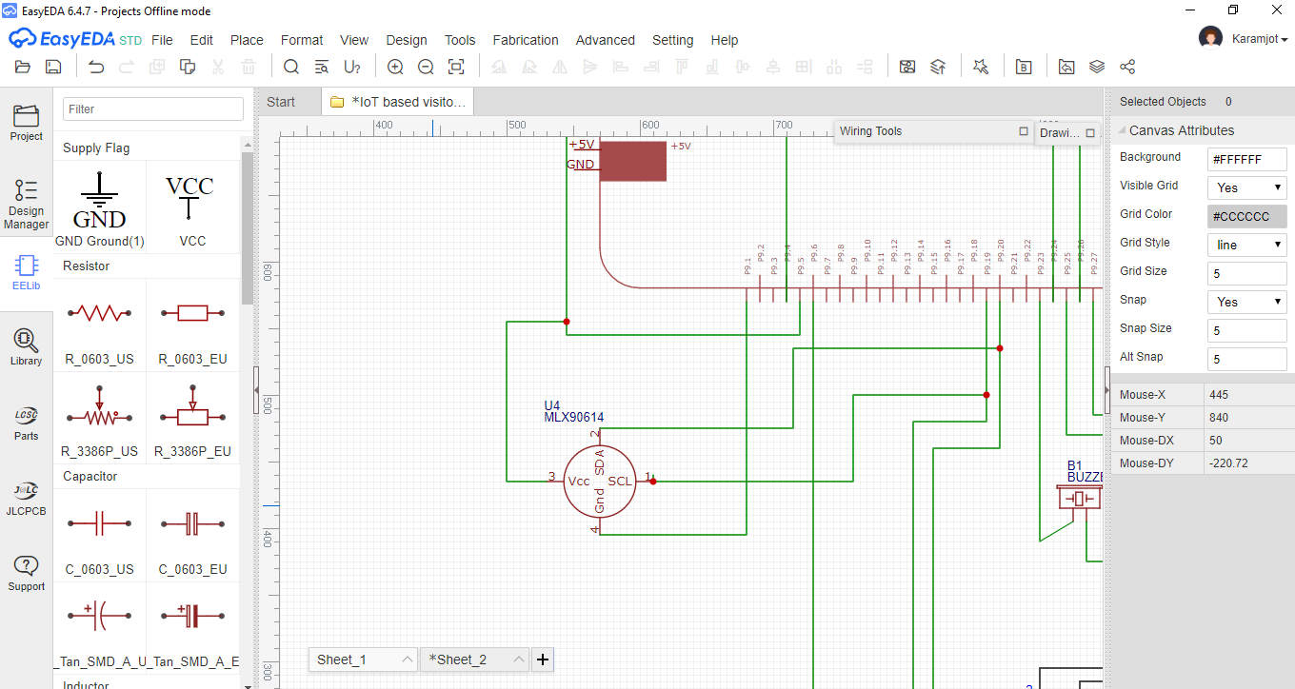
Connecting temperature sensor to BBb
For the interfacing of temperature sensor, I2C communication protocol is used.
SCL pin of the temperature is connected to the pin 19 of port 9
SDA pin of the sensor is connected to pin 20 of port 9
VCC is connected to pin 5 of port 9 and GND to pin 1 of port 8

Slide 18
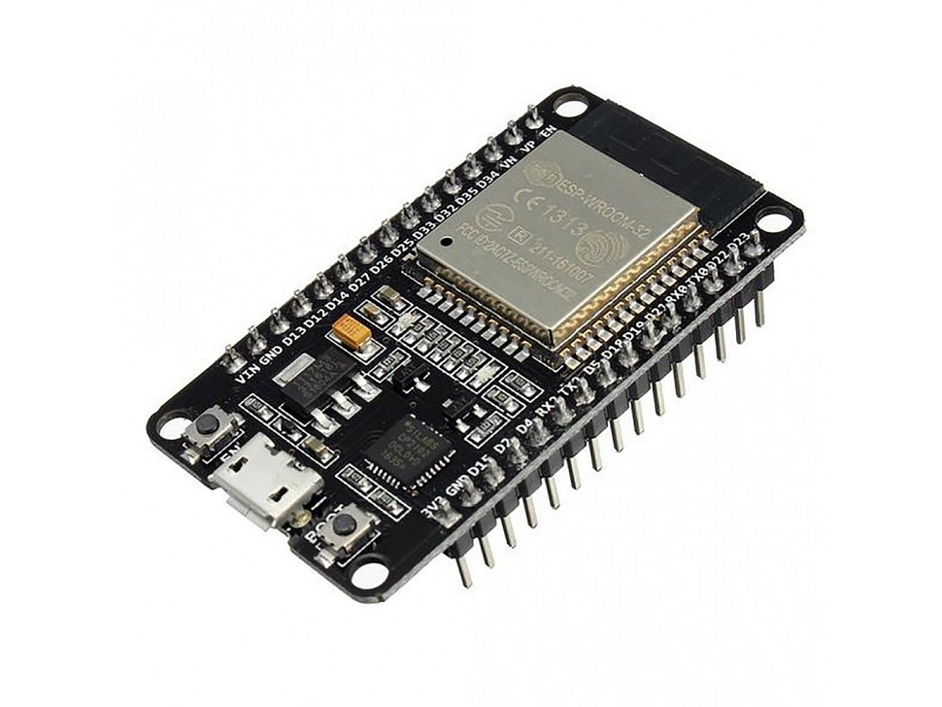
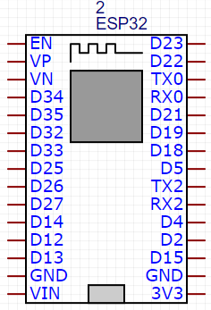
ESP 32
ESP 32 is used as Wi-Fi module to cloud services.
Operating voltage of ESP 32 is 3.3 V

Slide 19
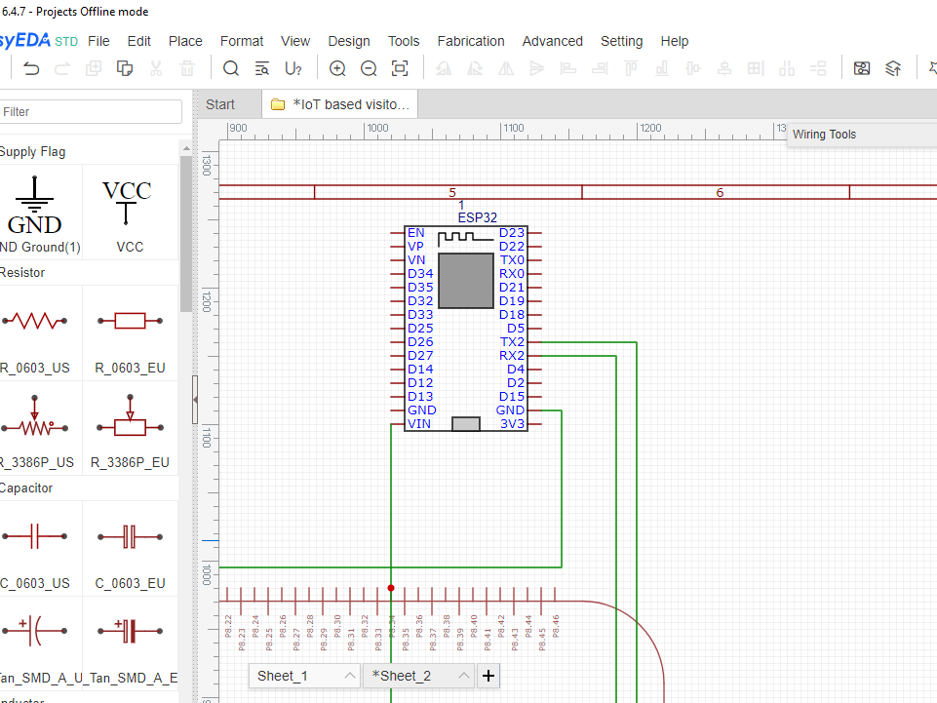
Connecting esp 32 to bbb
UART communication protocol is used to interfacing ESP 32 with BeagleBone Black.
Tx2 pin of ESP 32 is connect to pin 26 of port 9 and Rx2 pin is conected to pin 24 of port 9.
As operating voltage of ESP32 is 3.3V, VCC is connected to pin 4 of port 9 and GND is connected to pin 1 of port 8.

Slide 20
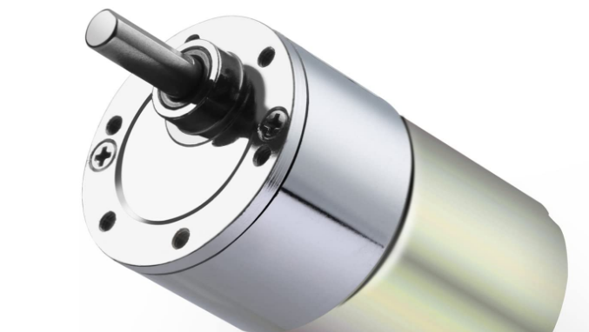
Dc motor
In this project, DC motor is used to control the gates at the entry and the exit. Operating voltage of motor is 12V and its speed is 10rpm. To run this motor, an external battery is used.

Slide 21
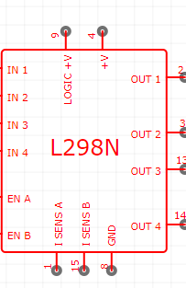
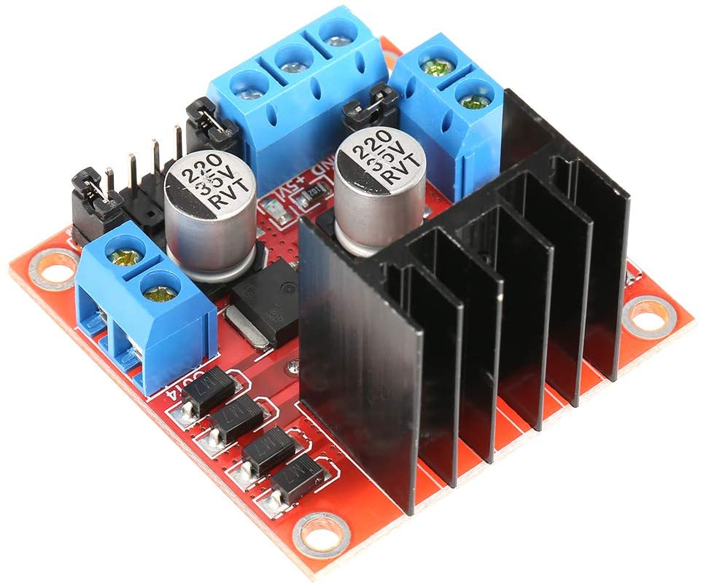
Motor driver
L298N motor driver is used in this project to run motors.
It is a dual motor driver, and both the motors can operate at same time.
Its operating voltage is 7 to 12V and maximum supply voltage is 45V
An external battery is used to run both motors and motor driver.

Slide 22
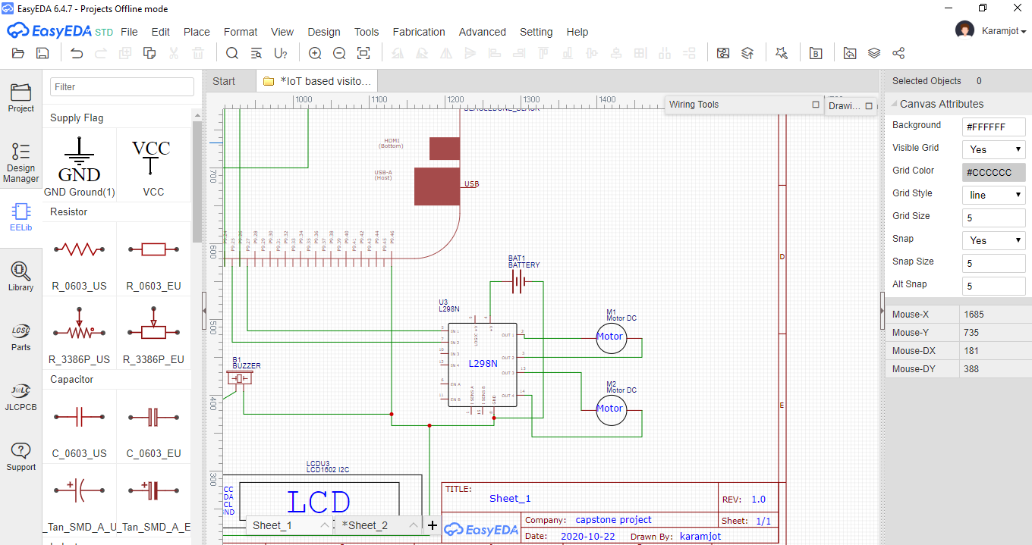
Connecting motor driver and motor to bbb
Motor Driver is connected to BBB using GPIO pins and Motors are connected at the output pins of motor driver
IN 1 pin of driver is connected to pin 27 of port 9 and IN 2 is connected to pin 25 of port 9
M1 is connected to OUT1 and OUT2 pins and M2 is connected to OUT3 and OUT4
VCC is connected to the external battery and GND is connected to the pin 46 of port 9

Slide 23
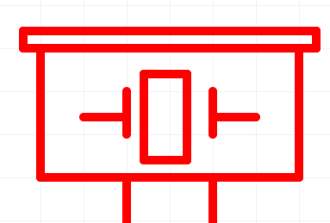
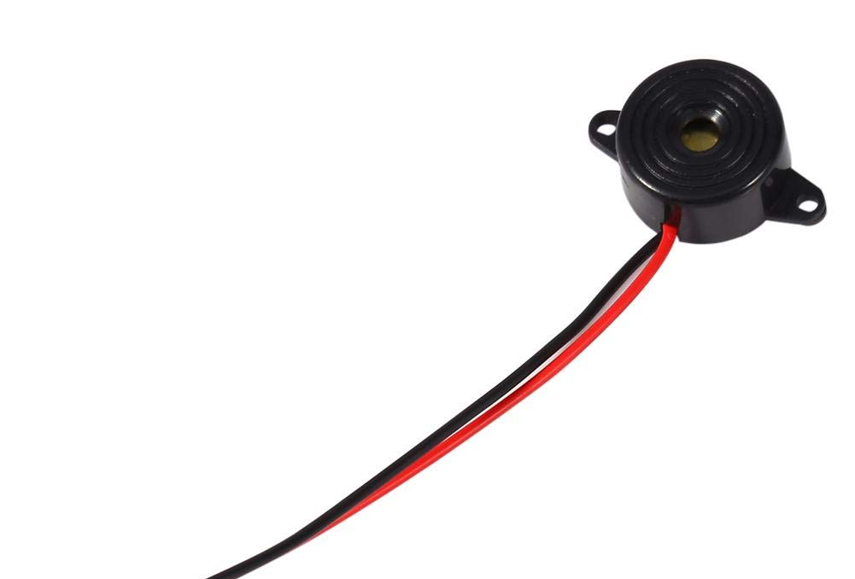
buzzer
In this project, buzzer is used to indicate that the temperature of customer is more than the threshold value.
Operating voltage of buzzer is 5V.

Slide 24
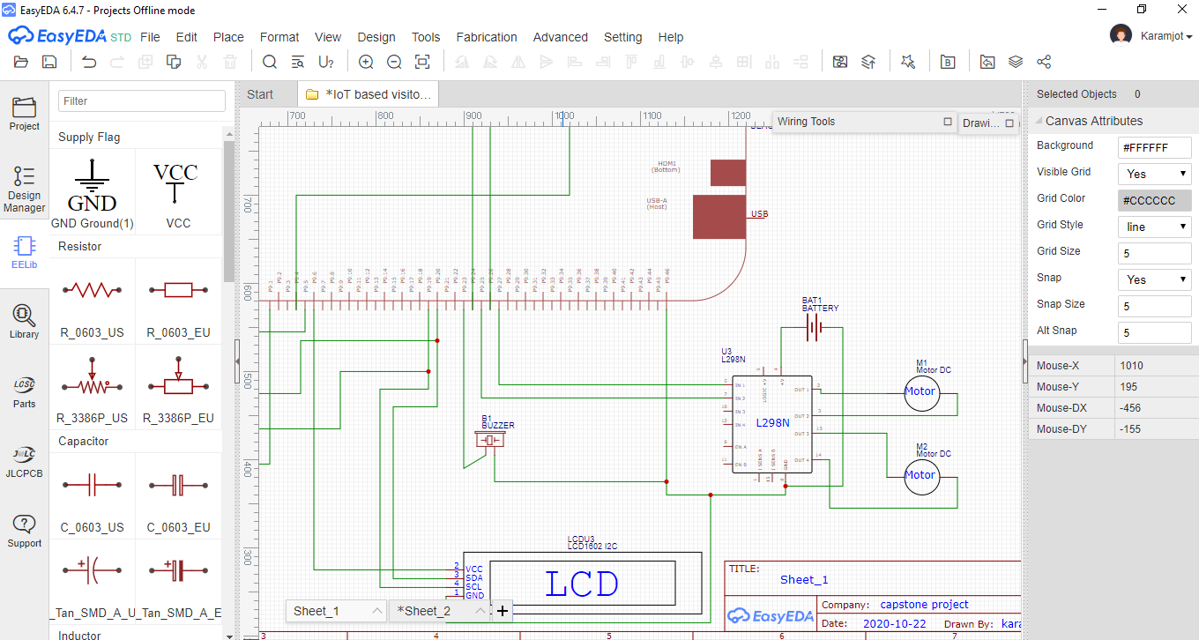
Connecting buzzer to bbb
Buzzer is connected to Beaglebone Black using GPIO pins.
NEGATIVE is connected to the pin 46 of port 9 and POSITIVE is connected to the pin 23 of port 9

Slide 25
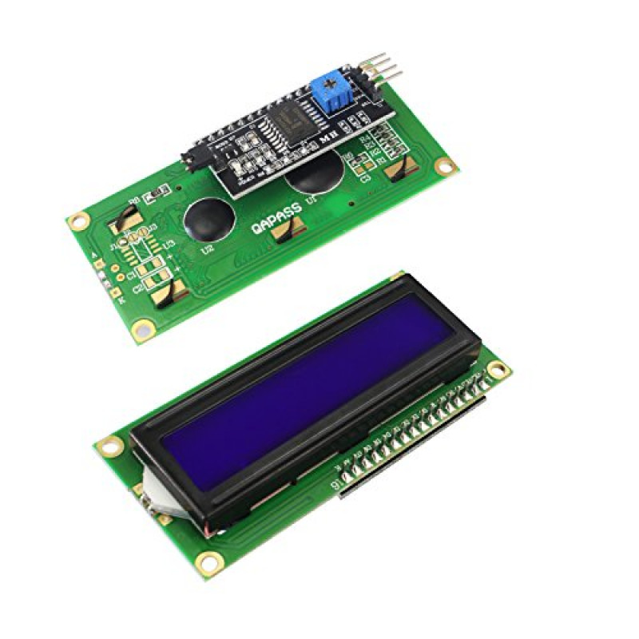
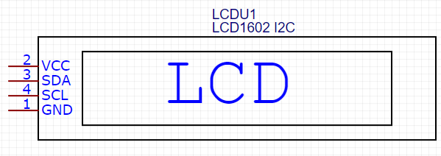
lcd
In this project 16*2 I2C LCD is used to display the total number of customers in the store.
Operating Voltage is 4.7V to 5.3V
Current consumption is 1mA without backlight.
Alphanumeric LCD display module, meaning can display alphabets and numbers

Slide 26
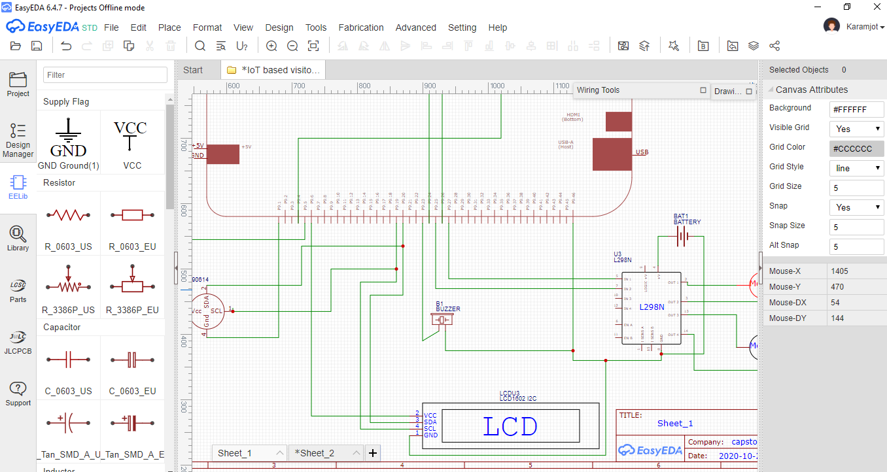
Connecting lcd to bbb
I2C communication protocol is used for interfacing between LCD and BeagleBone Black.
SCL pin of LCD is connected to pin 19 of port 9 and SDA is connected to pin 20 of port 9
VCC is connected to pin 6 of port 9 and GND is connected to pin 46 of port 9

Slide 27
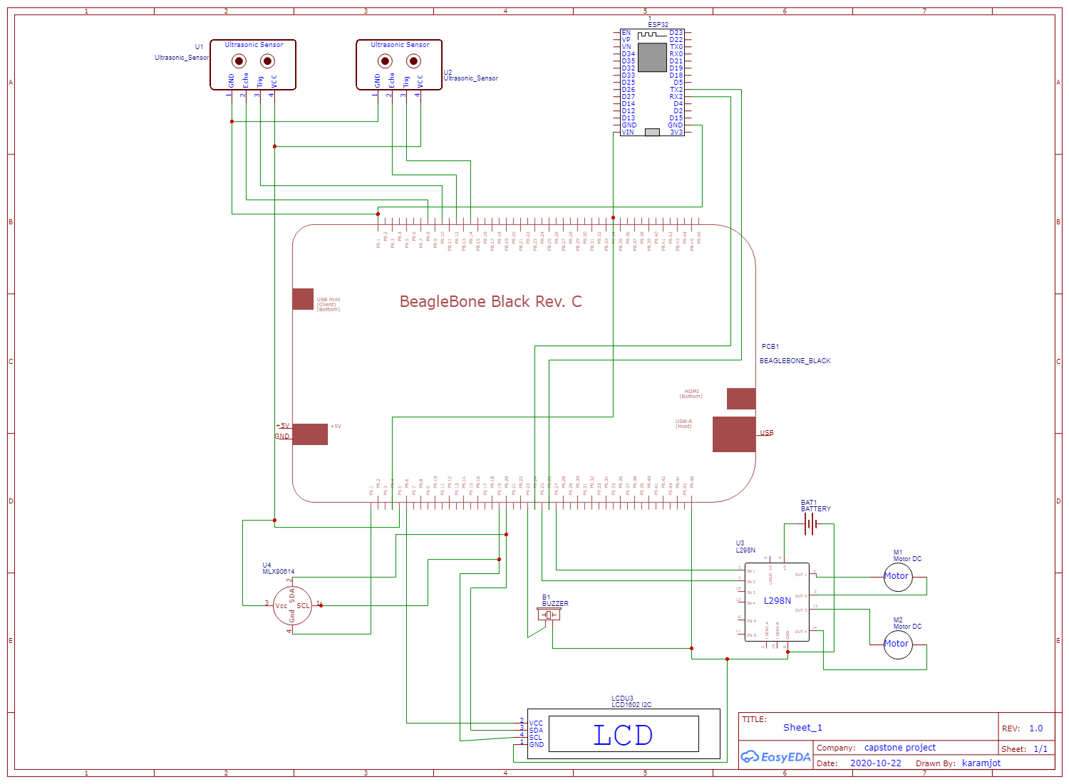
Final schematic

Slide 28
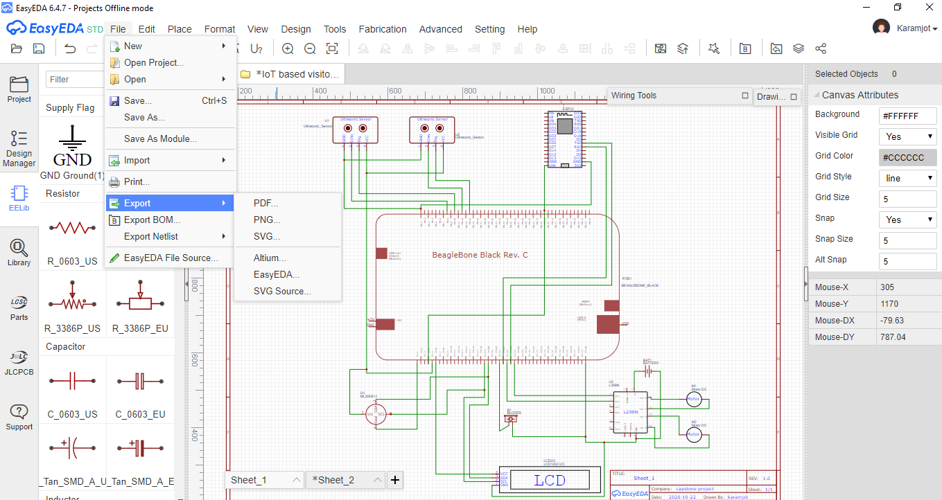
Exporting final file
Finally, once the schematic is done, export the file in the desired format.
File can be saved in PDF, PNG and SVG format.

Slide 29
Reference
Depuy, T. (2015, June 4). The Internet of Things Includes Annoying Buzzers. Intelligent Communication Blogs (x) Matters. Retrieved from: https://www.xmatters.com/blog/incident-management/blog-the-internet-of-things-includes-annoying-buzzers/
Lewis, N. (2013, April 30). Using a Beaglebone with an HSCR-04 sonar. YouTube. Retrieved from https://www.youtube.com/watch?v=bssyOCcU_Q4
robocircuits. (2017, October 11). How to test L298N motor driver board - Tutorial. YouTube. Retrieved from: https://www.youtube.com/watch?v=_TEZ2-3H0GY
Driving 1602 LCD with PCF8574 / PCF8574A. (N.D.). Mediatek Labs. Retrieved from : https://docs.labs.mediatek.com/resource/linkit7697-arduino/en/tutorial/driving-1602-lcd-with-pcf8574-pcf8574a
EasyEDA Full TUTORIAL + Create Component + TIPS. (2019, October 13). Retrieved from https://www.youtube.com/watch?v=utBQqcuOt9U
Beagleboy. (2020, April 4). Beaglebone and MLX90614 infrared thermometer example in Python. Beaglebone.net. Retrieved from : https://www.beaglebone.net/code/python/beaglebone-and-mlx90614-infrared-thermometer-example-in-python.php

Slide 30
Reference
Robocircuits. (2017, October 11). How to test L298N motor driver board - Tutorial. YouTube. Retrieved from : https://www.youtube.com/watch?v=_TEZ2-3H0GY
Psi, T. (2017, March 12). How to connect your “L298N Dual H-Bridge Motor Controller” to “Arduino Uno”. YouTube. Retrieved from : https://www.youtube.com/watch?v=OkHR1BZCcqA
Admin. (2015, June 5). BEAGLEBONE BLACK LESSON 1: UNDERSTANDING BEAGLEBONE BLACK PINOUT. Technology Tutorials. Retrieved from : https://toptechboy.com/beaglebone-black-lesson-1-understanding-beaglebone-black-pinout/

Slide 31
Thank you

